Slide 1


Blended intensive programe – Introduction to OpenSim

Slide 2
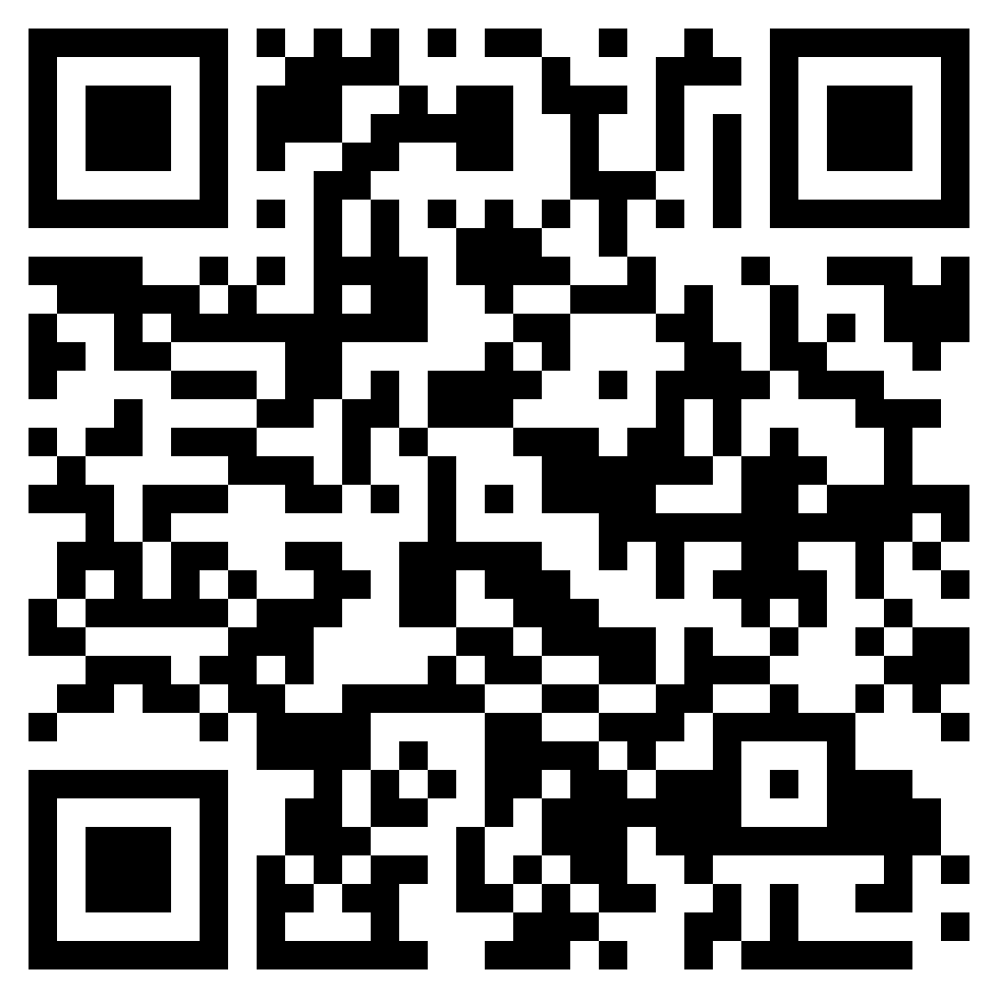
https://github.com/basgoncalves/BIP_OpenSim_Hungarian_USports
Notes:
https://github.com/basgoncalves/BIP_OpenSim_Hungarian_USports

Slide 3
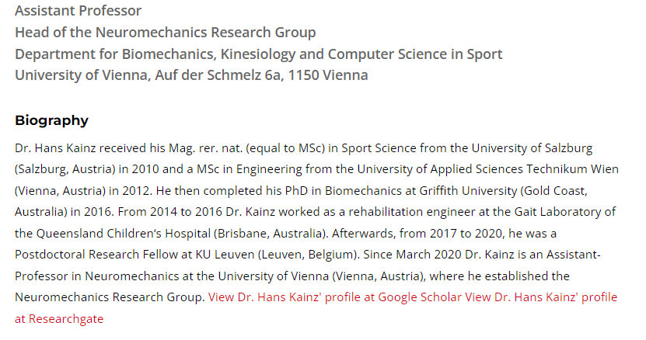
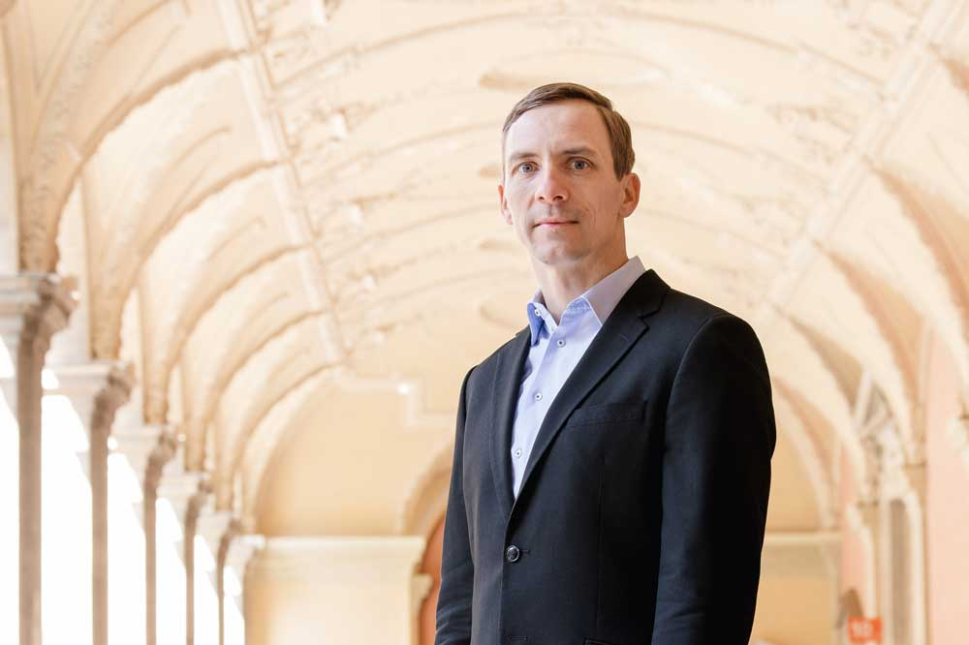
Hans
Who are we?

Slide 4
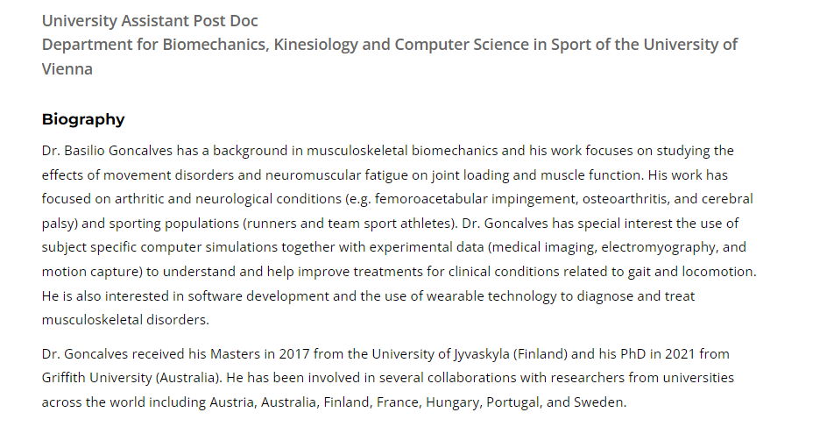

Bas
Who are we?

Slide 5
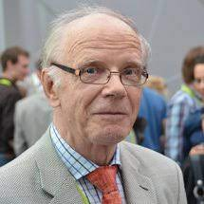
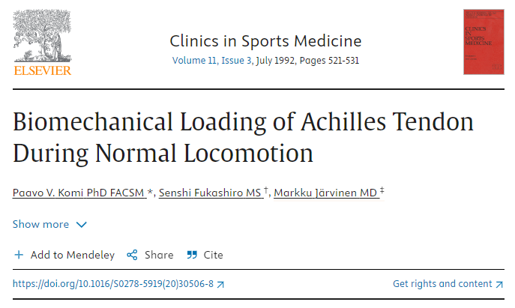
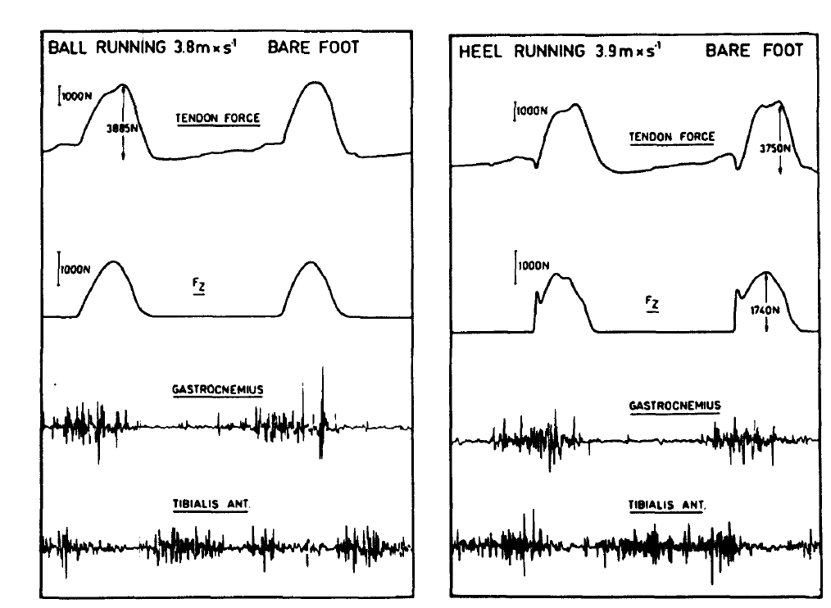
Why do we care?

Slide 6
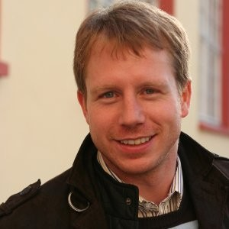
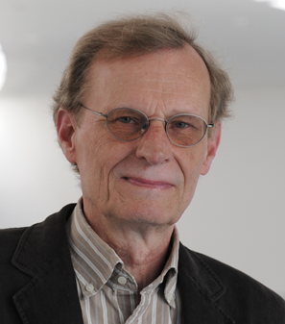
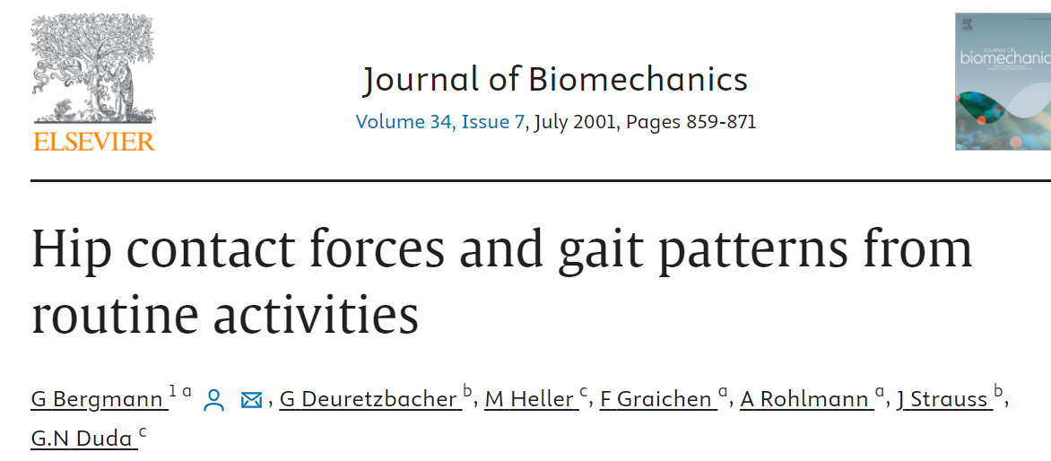
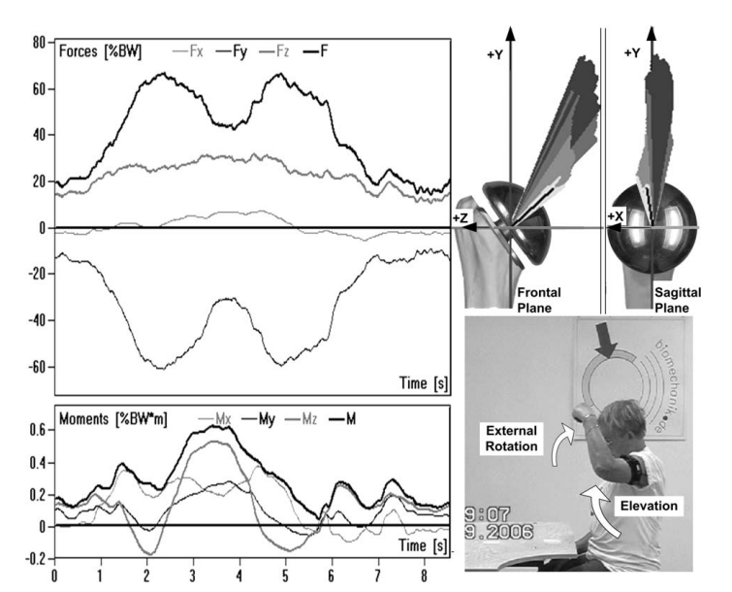
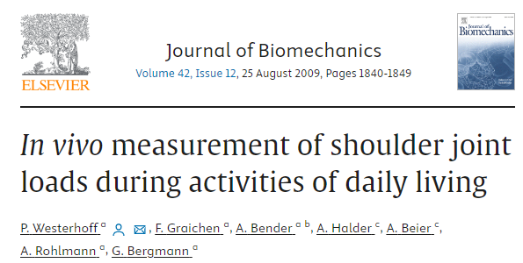
Why do we care?
Notes:
https://www.sciencedirect.com/science/article/abs/pii/S0021929009003169?via%3Dihub
https://www.sciencedirect.com/science/article/abs/pii/S0021929001000409?via%3Dihub

Slide 7
Main problems with in-vivo measurements
Why do we care?
Invasive
Cannot measure more than one muscle group
May alter individuals movement patters

Slide 8


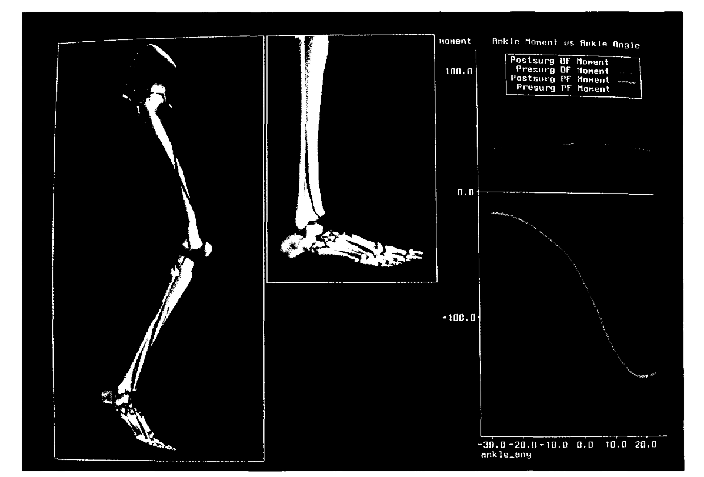
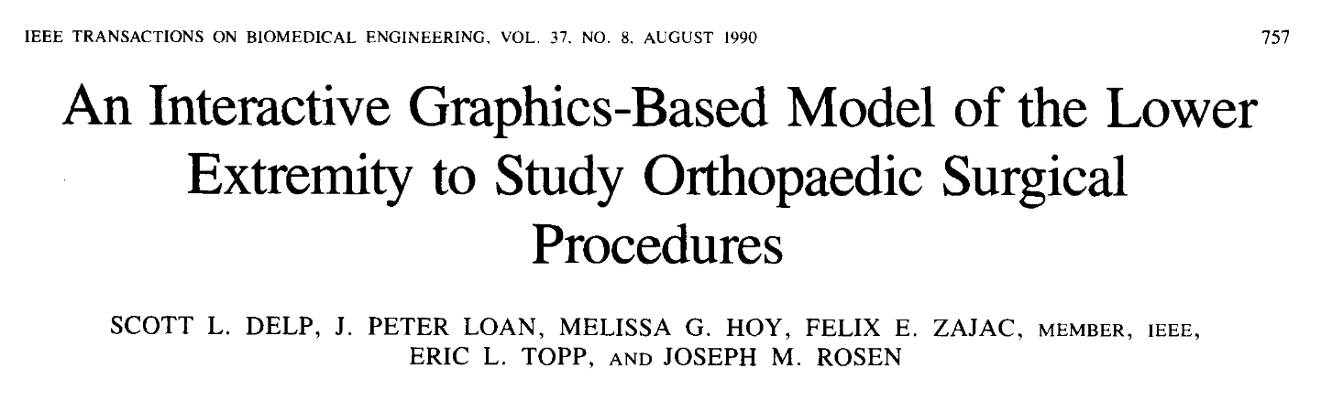
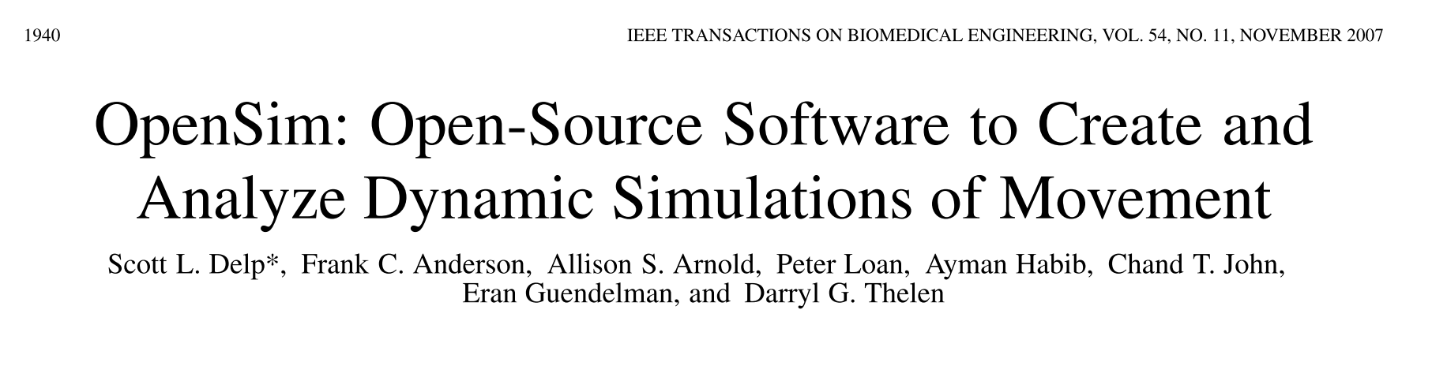

Slide 9
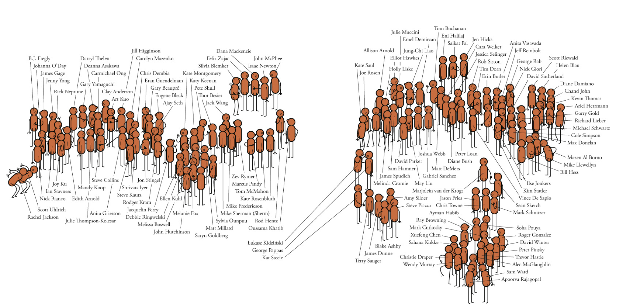

Slide 10
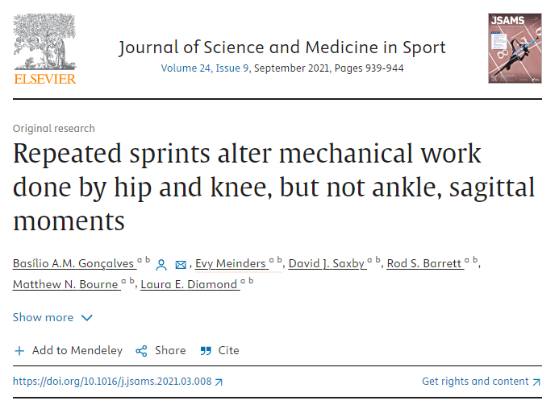
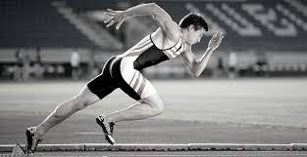
Why do we care?

Slide 11
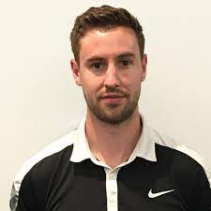
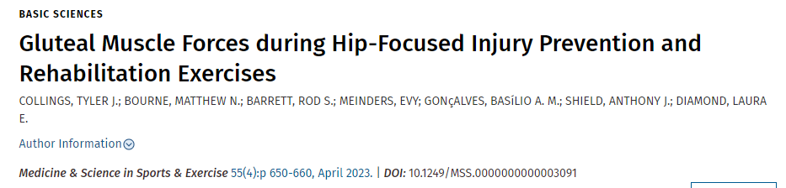
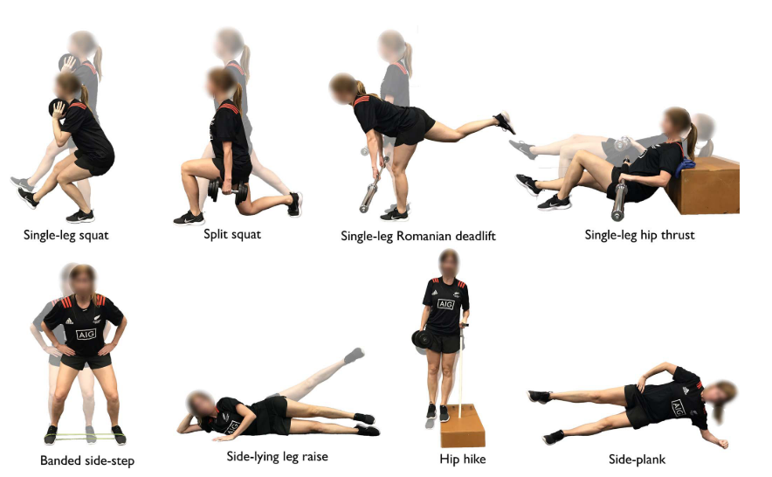
Why do we care?

Slide 12
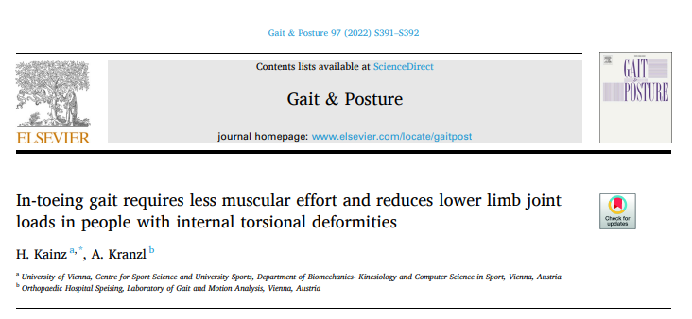
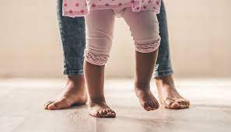
Why do we care?

Slide 13

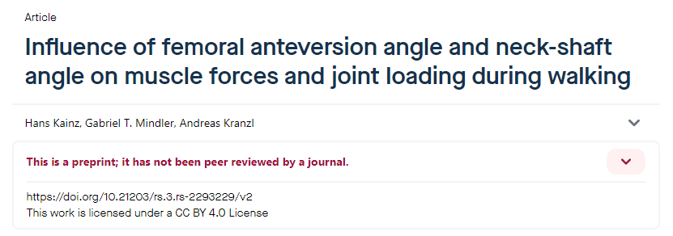
Why do we care?

Slide 14
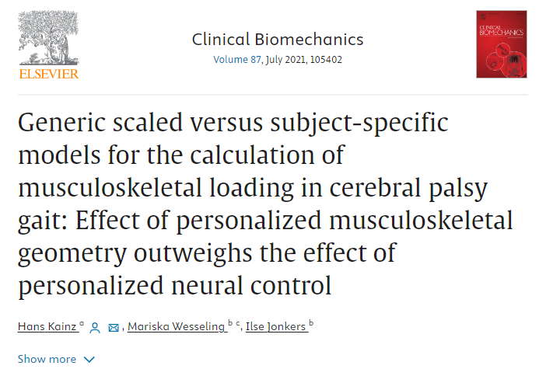
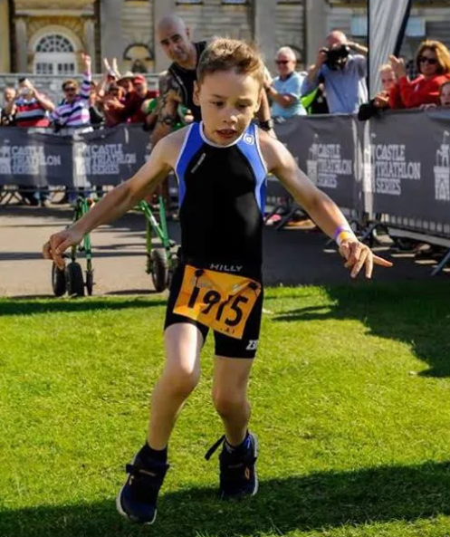
Why do we care?

Slide 15
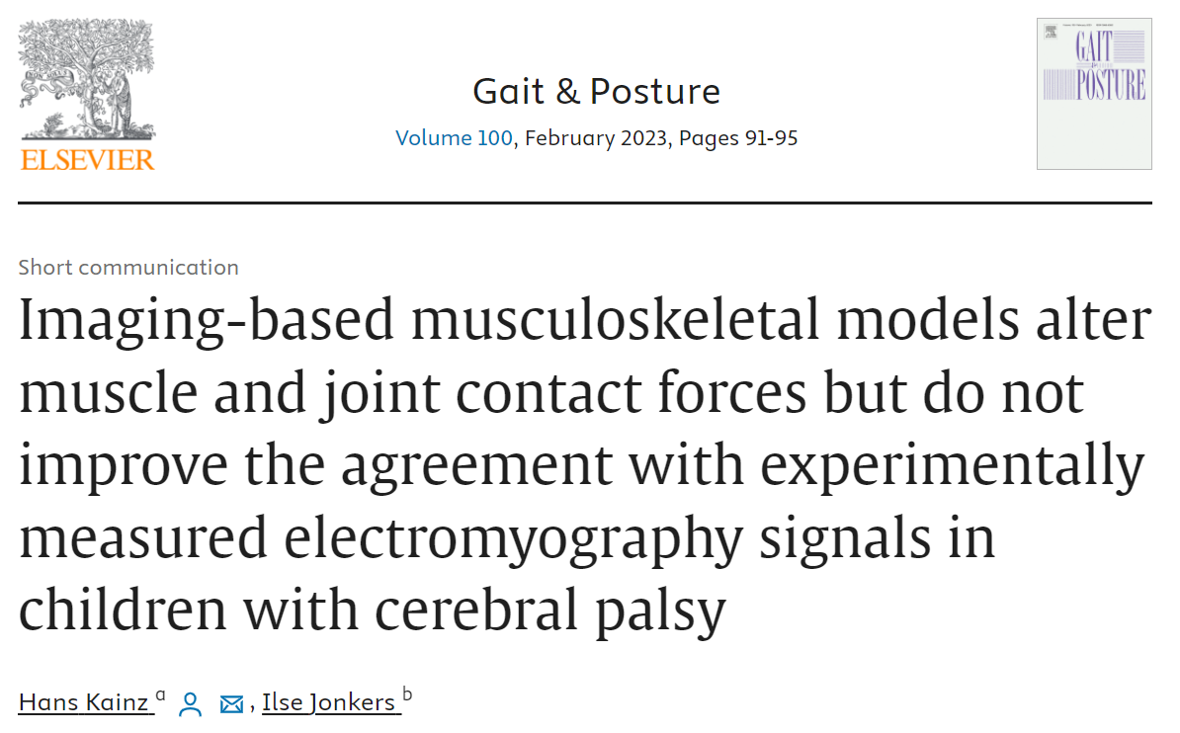
Why do we care?
Notes:
https://www.sciencedirect.com/science/article/abs/pii/S0966636222006567

Slide 16
Musculoskeletal (MSK) modeling
Introduction to rigid body and muscle-tendon modelling;
Data collection
Traditional gait analysis
Advantages of MSK modeling
What is a MSK model?

Slide 17
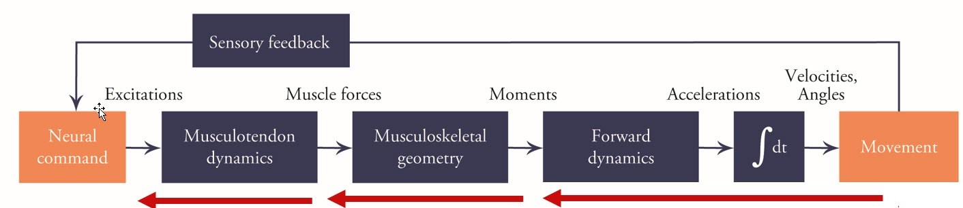
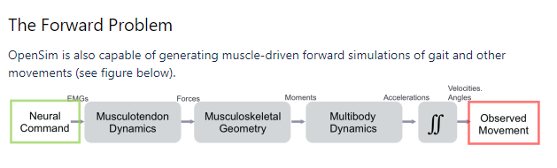
Inverse vs forward simulations
Introduction to rigid body and muscle-tendon modelling;

Slide 18
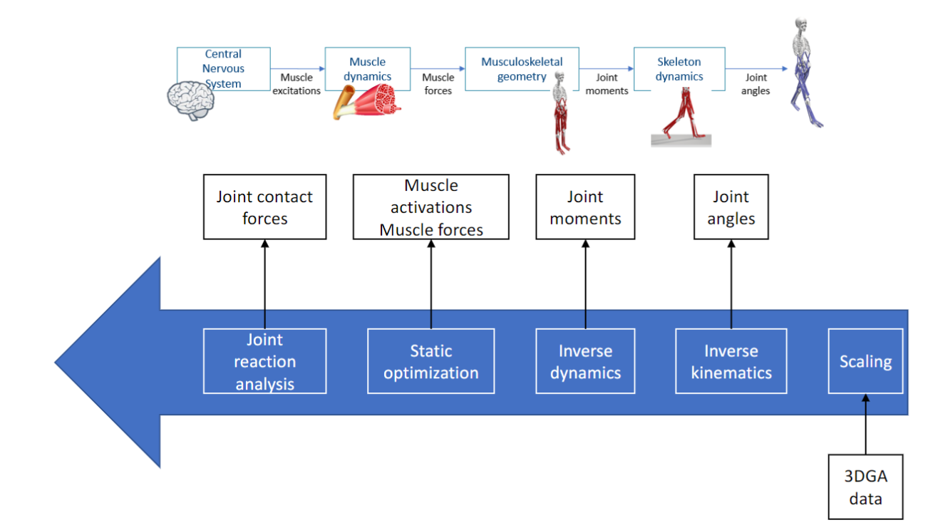
Inverse approach
Introduction to rigid body and muscle-tendon modelling;

Slide 19
Musculoskeletal (MSK) modeling
Introduction to rigid body and muscle-tendon modelling;
…

Slide 20
Musculoskeletal (MSK) modeling
Introduction to rigid body and muscle-tendon modelling;
…

Slide 21
What is a model?
Introduction to rigid body and muscle-tendon modelling;
Sf

Slide 22
Check the cheat sheet?
Introduction to rigid body and muscle-tendon modelling;
‘ .\Cheat_sheet.pdf

Slide 23
OpenSim dependencies
Introduction to rigid body and muscle-tendon modelling;
OpenSim 4.4 (need a login account to download)
Notepad ++
Mokka
Excel or equivalent
Python 3.8 (optional)
Git (optional)
VScode (optional)

Slide 24
File types
Introduction to rigid body and muscle-tendon modelling;
.c3d
.trc
.mot
.sto
.xml
.osim

Slide 25

Time to practice (demo opensim quick to check how fast they learn)
Introduction to rigid body and muscle-tendon modelling;

Slide 26
Questions (10-25)
Introduction to rigid body and muscle-tendon modelling;
Explore files
Load model in opensim

Slide 27
Run your first simulation
Introduction to rigid body and muscle-tendon modelling;
C:\Users\Biomech\Documents\OpenSim\4.4\Models
Load model in opensim

Slide 28
Running models is simulations easy, but …
Introduction to rigid body and muscle-tendon modelling;
Where do they come from

Slide 29
What were the first models
Introduction to rigid body and muscle-tendon modelling;
…

Slide 30
Why do we do it?
Introduction to rigid body and muscle-tendon modelling;
…

Slide 31
How do we do it? How we they developed?
Introduction to rigid body and muscle-tendon modelling;
…

Slide 32
Run your second simulation
Introduction to rigid body and muscle-tendon modelling;
C:\Users\Biomech\Documents\OpenSim\4.4\Models\Walking
Run

Slide 33
Run your second simulation (20-30)
Introduction to rigid body and muscle-tendon modelling;
C:\Users\Biomech\Documents\OpenSim\4.4\Models\Walking
Run
Questions

Slide 34
Break
Introduction to rigid body and muscle-tendon modelling;

Slide 35
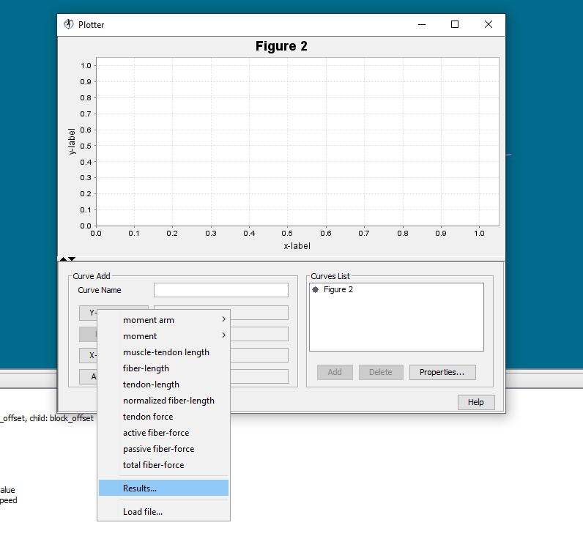
Plotting results
Introduction to rigid body and muscle-tendon modelling;

Slide 36
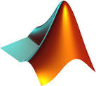

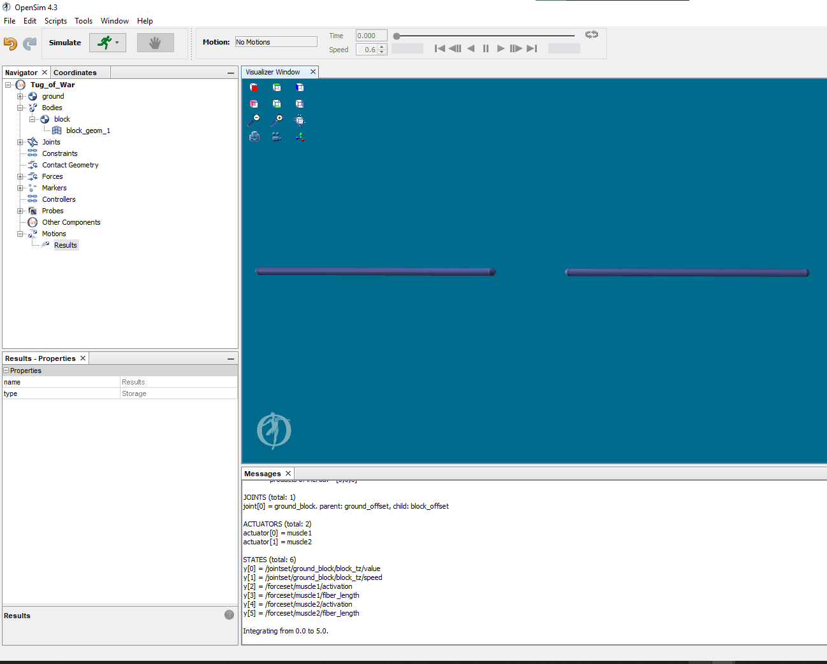
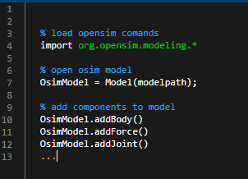
GUI vs CMD
Introduction to rigid body and muscle-tendon modelling;
C:\Users\Biomech\Documents\OpenSim\4.4\Code
https://simtk.org/api_docs/opensim/api_docs/

Slide 37
How are muscles modelled
Introduction to rigid body and muscle-tendon modelling;
Single sarcomere

Slide 38
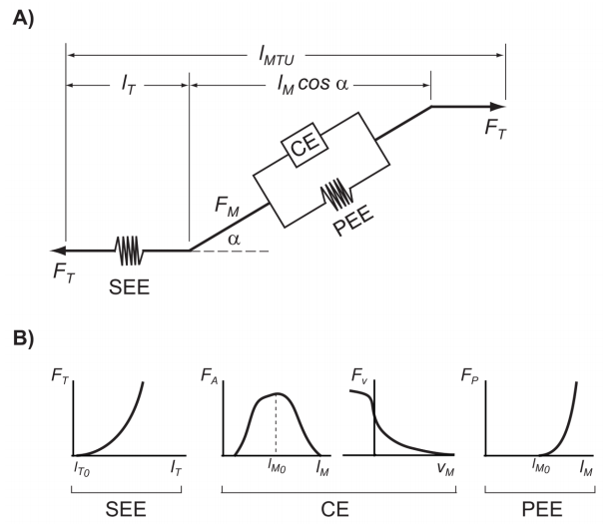
Forces / muscle mechanics
Optimal fibre length
Tendon slack length
Maximum isometric force
Pennation angle at optimal fibre length
Maximum contraction velocity

Slide 39
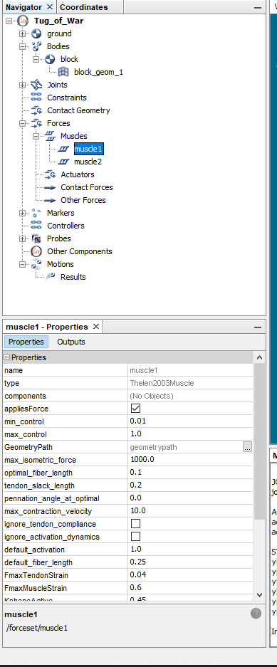
Change muscle parameters (20-30)

Slide 40
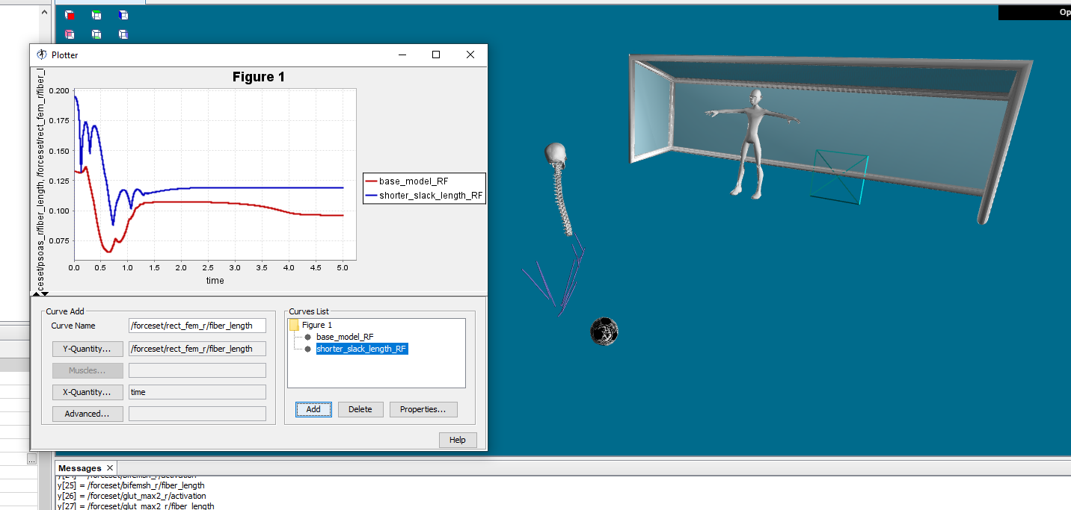
Run the soccer simulation

Slide 41
Questions (30-45 min)

Slide 42
Musculoskeletal (MSK) modeling
Model personalization, Estimation of joint angles and external joint moments
Scaling
IK
ID

Slide 43
Time to practice (scale mode with wrong settings)
Introduction to rigid body and muscle-tendon modelling;
.\ExampleData\Bone_deformities\simulations\P01\pre\Static03

Slide 44
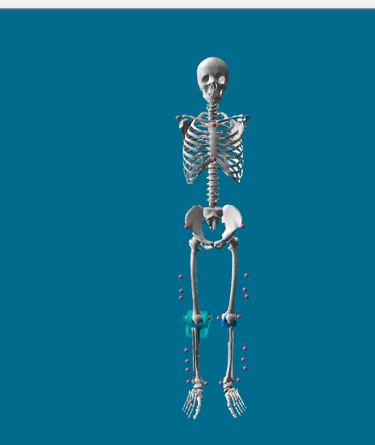
Scaling problems
Model personalization, Estimation of joint angles and external joint moments
Marker position
Marker weights
Check marker errors

Slide 45
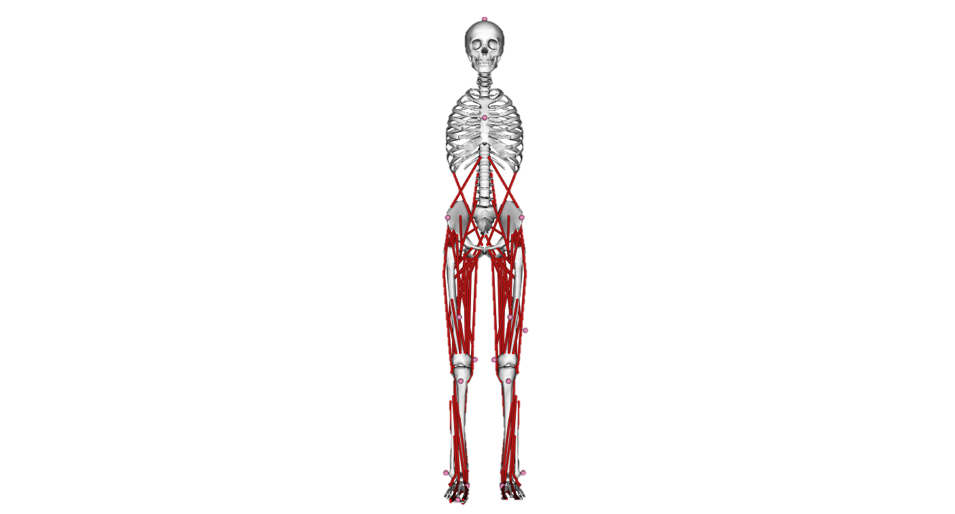
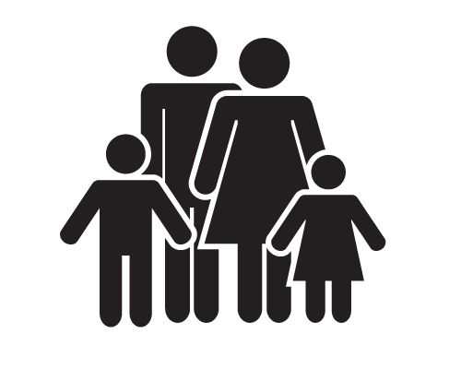

Why scaling?
Generic model

Slide 46
Why scaling?
Generic model

Slide 47
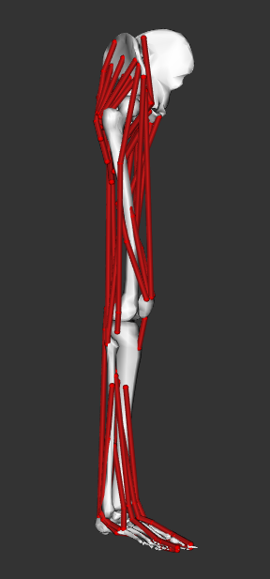
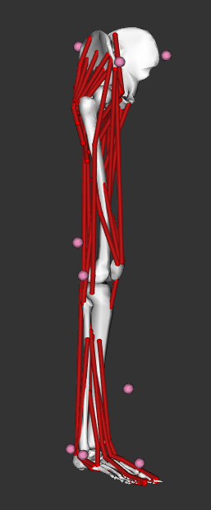
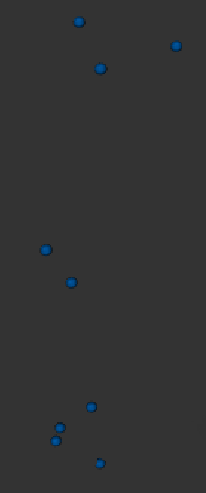
Scaling
Model + model markers
Experimental markers
Generic model

Slide 48
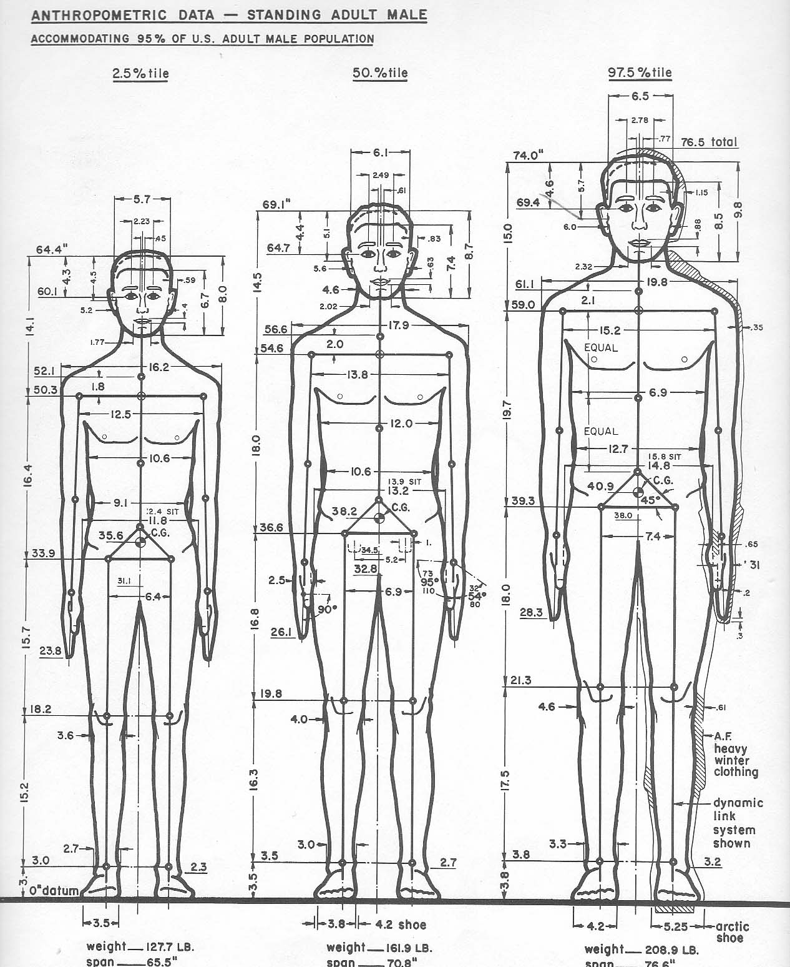
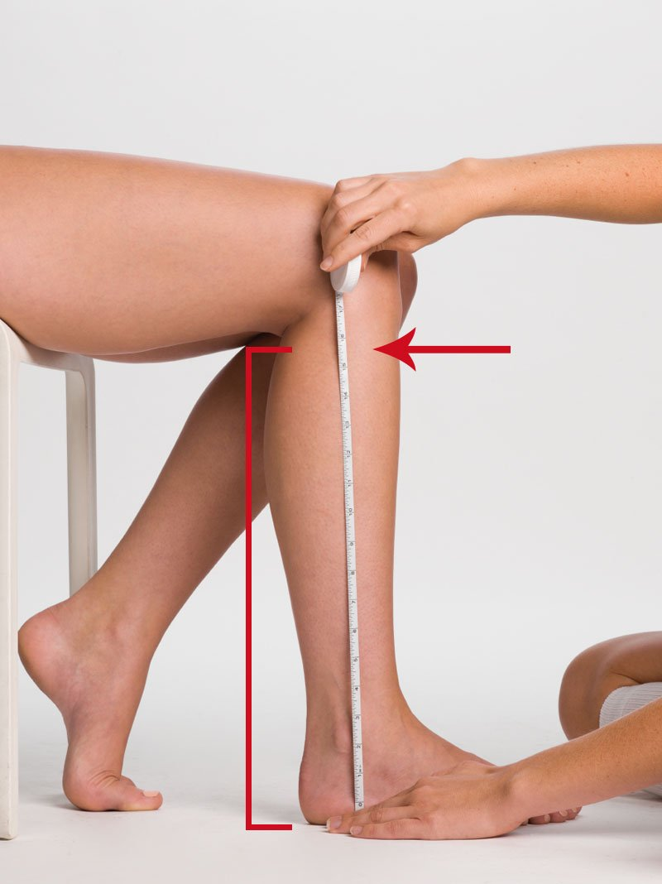
Definition of scale factors
Measurement-based scaling
Manual scaling
specified by the user based on some predetermined measure
e.g. anthropometric measurements
Generic model
Scaled model
Experimental markers
Model markers

Slide 49
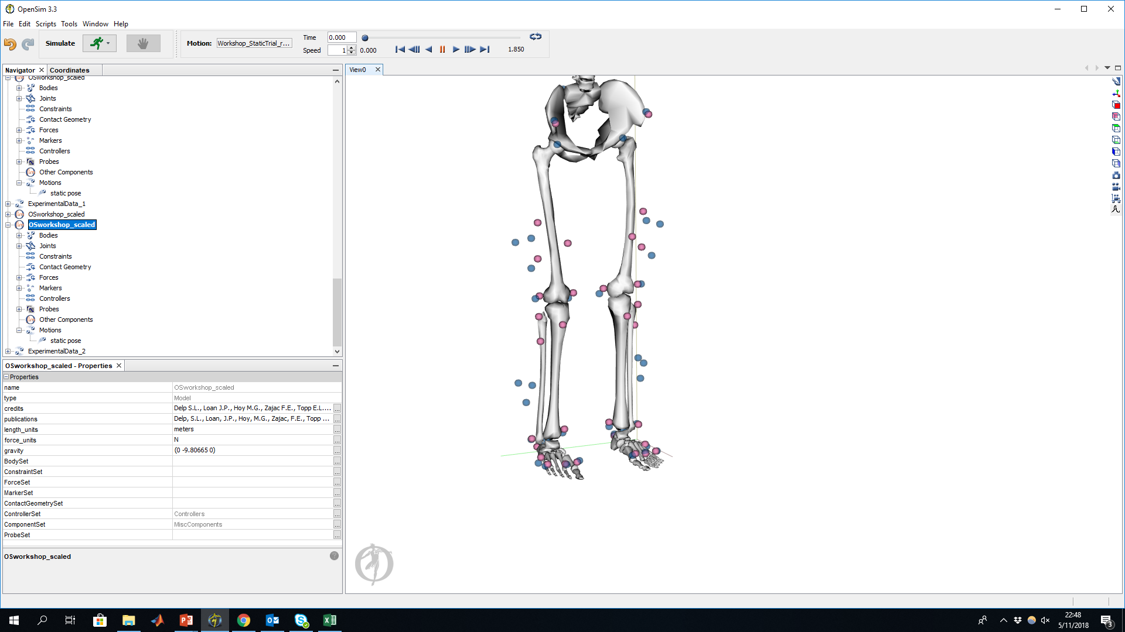
Adjust model markers
adjusts the model markers to match the experimental markers at the static pose
Experimental markers
Model markers

Slide 50
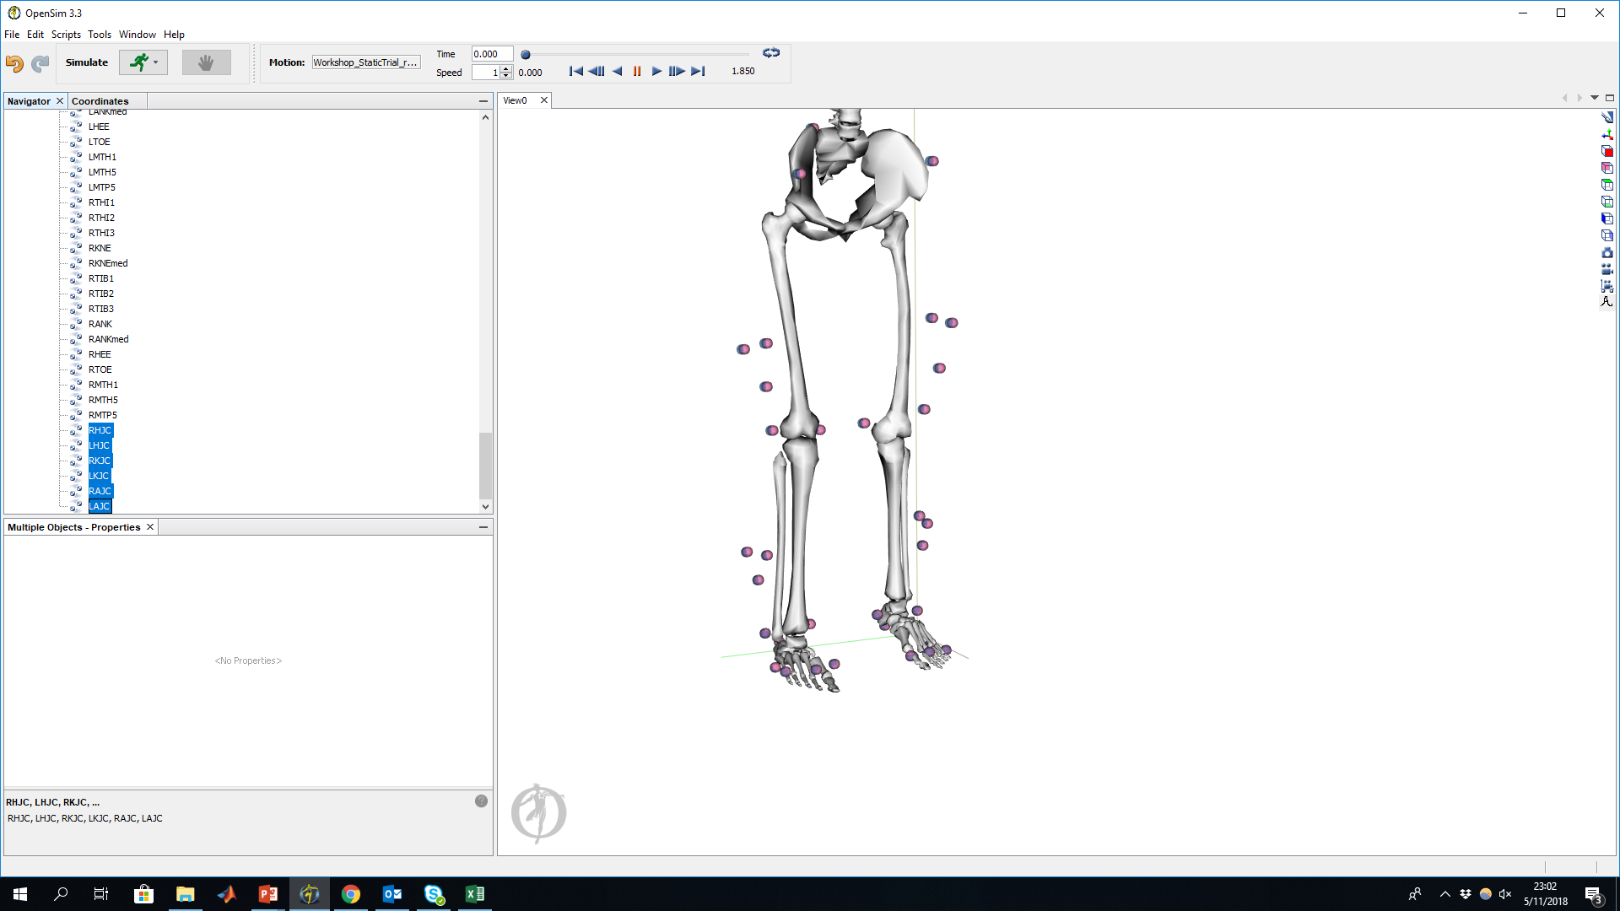
Scaled model
Experimental markers
Model markers

Slide 51
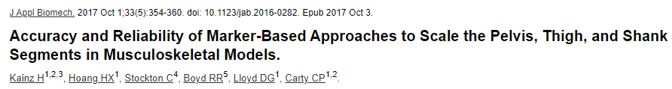
Hints
Scaling can have a big impact on your simulation results
Use joint centers for scaling in participants with movement disorders

Slide 52
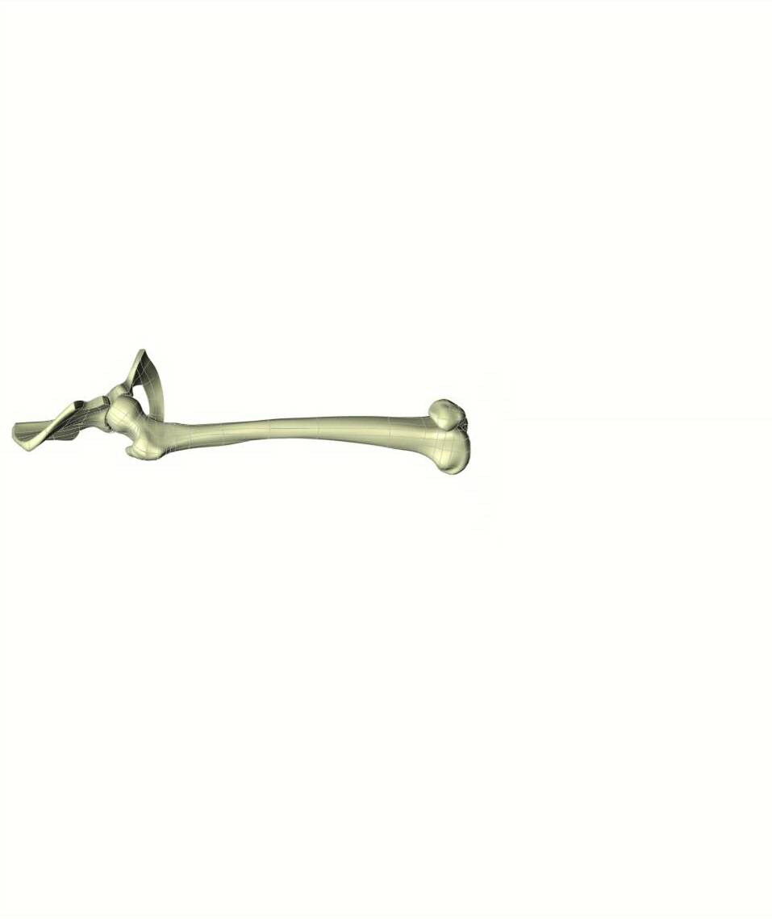
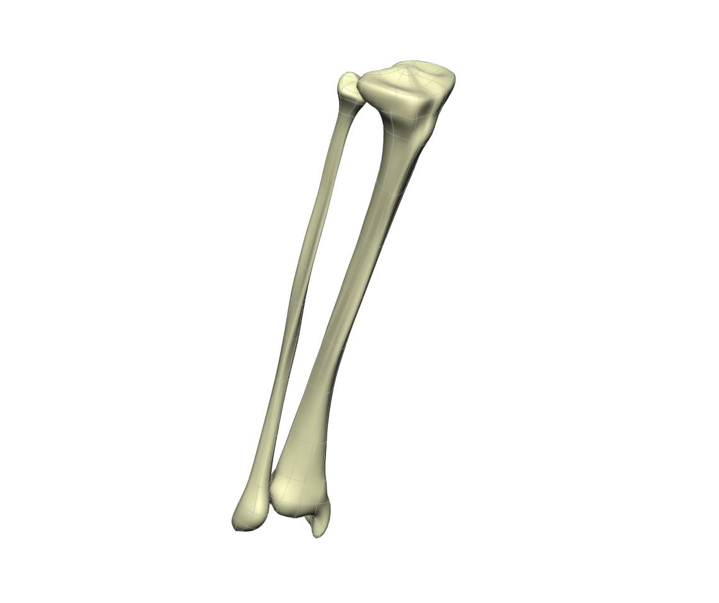
Direct Kinematics (DK)
Markers are rigidly attached to bones
Davis, 1988
Kadaba et al., 1989
Kadaba et al., 1990
Notes:
In Direct Kinematics it is assumed that the markers are rigidly attached to the bones. That means that it is assumed that no movements occur between the surface markers and the underlying bones. However, we know that this is not the case. If a person moves, soft tissue artefacts due to the movement of body segments and muscle contractions, change the position of the surface markers relative to the underlying bones.
The blue circles in this figure represent surface markers. The green circles represent joint centres which are also known as virtual markers.
Let’s assume that there is a lot of soft tissue artefacts at the shank segment and see what happens.

Slide 53
Direct Kinematics (DK)
Markers are rigidly attached to bones
Davis, 1988
Kadaba et al., 1989
Kadaba et al., 1990
Notes:
That’s a lot more soft tissue artefacts than in reality occurs but I want to show you what happens to the underlying skeletal model.

Slide 54
Direct Kinematics (DK)
Markers are rigidly attached to bones
Bone can change length
Davis, 1988
Kadaba et al., 1989
Kadaba et al., 1990
Notes:
Either it changes the segment lengths, in this case the shank segment.

Slide 55
Direct Kinematics (DK)
Markers are rigidly attached to bones
Bone can change length
Davis, 1988
Kadaba et al., 1989
Kadaba et al., 1990
Notes:
Or

Slide 56
Direct Kinematics (DK)
Markers are rigidly attached to bones
Bone can change length
Joints can fly apart
Davis, 1988
Kadaba et al., 1989
Kadaba et al., 1990
Notes:
It changes the position of the segment. That means the joints can fly apart. Neither, the change in bone length nor the change of the relative position of the segment is physiological correct. That’s one of the biggest drawbacks of Direct Kinematic approaches.

Slide 57

MSK modeling
Static calibration trial
Scaling
Scaled anatomical model
Dynamic walking trials
Inverse Kinematics
Joint angles
Inverse Dynamics
Joint moments
Muscle moment arms
Muscle-tendon lengths
Muscle forces, etc
Musculoskeletal analyses
Delp et al., 2007

Slide 58
Inverse kinematics (IK)
Experimental markers
Model markers
Notes:
Let’s play the same game as before and assume we have a participant with a lot of soft tissue and the markers are moving relative to the underlying bone. On the first picture here we can see the perfect case. All the model markers perfectly match the experimental markers. That’s the reason why we only see the model markers on this figure. The experimental markers are underneath the red model markers.

Slide 59
Inverse kinematics (IK)
Experimental markers
Model markers
Notes:
Let’s assume the experimental markers of the shank segment are a lot more distal compared to the model markers of the shank. Same initial situation as we had before when we were looking at the Direct Kinematics approach.

Slide 60
Inverse kinematics (IK)
Markers are NOT rigidly attached to bones
Fixed bone length
Constrained joint movements
Experimental markers
Model markers
Notes:
Inverse Kinematics changes the pose of the model, without changing the segment lengths or allowing the joints to fly apart, to match the position of the experimental markers as good as possible.
Let’s summarize the Inverse Kinematics approach again:
It is NOT assumed that the markers are rigidly attached to the bones but we have a rigid generic model, which does not allow changes in bone lengths after scaling. Furthermore, joint movements are constrained which prevents un-physiological joint movements.

Slide 61
Time to practice (IK with wrong weights)
Introduction to rigid body and muscle-tendon modelling;
.\ExampleData\Bone_deformities\simulations\P01\pre\dynamic04_l

Slide 62
Time to practice (IK with wrong weights )
Introduction to rigid body and muscle-tendon modelling;
.\ExampleData\Bone_deformities\simulations\P01\pre\Static03

Slide 63

Torque (τ)/Moment (M)
Introduction to rigid body and muscle-tendon modelling;
The tendency of a load to produce a rotation (not a translation!)
τ or M is the cross product of the
Applied force (F)
Moment arm (r): shortest distance between the line of force and the axis of rotation
M = F × r

Slide 64

Torque (τ)/Moment (M)
Introduction to rigid body and muscle-tendon modelling;

Slide 65
Time to practice (prepare the GRF files)
Introduction to rigid body and muscle-tendon modelling;
.\ExampleData\Bone_deformities\simulations\P01\pre\dynamic04_l

Slide 66
Questions
Introduction to rigid body and muscle-tendon modelling;

Slide 67
Muscle forces in openSim
Estimation of muscle and joint contact forces
Garbage in garbage out
Check the inputs
Moment arm

Slide 68

Muscle moment arms
Estimation of muscle and joint contact forces

Slide 69
Muscle moment arms
Estimation of muscle and joint contact forces

Slide 70
Theroy muscle and static opt
Estimation of muscle and joint contact forces

Slide 71
Time to practice (static optimisation)
Introduction to rigid body and muscle-tendon modelling;
.\ExampleData\Bone_deformities\simulations\P01\pre\dynamic04_l

Slide 72
Questions about the muscle forces
Estimation of muscle and joint contact forces

Slide 73

Calculations joint contact forces
Estimation of muscle and joint contact forces
Parent or child
Body orientations

Slide 74
Effects of surgery transfer
Simulate the effects of musculoskeletal alterations on muscle and joint loads
#

Slide 75
Muscle and joint loading during running
Simulate the effects of musculoskeletal alterations on muscle and joint loads
#

Slide 76
Effects of bone geometry on joint loading
Simulate the effects of musculoskeletal alterations on muscle and joint loads
TD01 and P01

Slide 77
Musculoskeletal (MSK) modeling
Summary and future directions
Data collection
Traditional gait analysis
Advantages of MSK modeling
What is a MSK model?

Slide 78
Musculoskeletal (MSK) modeling
Summary and future directions
Data collection
Traditional gait analysis
Advantages of MSK modeling
What is a MSK model?

